Slide 1

The Machine Learning Process
Python 101 – Errors and Exception Handling
Sathish Ravichandran

Slide 2

Why do we need to handle errors?
If we handle our errors, our program will likely continue to function after an error and user can likely continue working.
If you did not handle the errors, if the program crashes, we lose all our work and we won't know where the bug occurred.

Slide 3

How do we handle errors?
Try: This is the block of code to be attempted
Except: Block of code will execute in case there is an error in try block
Finally: A final block of code to be executed, regardless of an error.

Slide 4
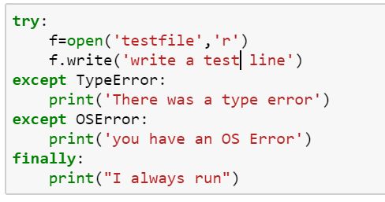

Example 01
#Opening file with read only permission
#And we are trying to write to the file
What is the expected output here?
Notes:
try:
f=open('testfile','r')
f.write('write a test line')
except TypeError:
print('There was a type error')
except OSError:
print('you have an OS Error')
finally:
print("I always run")

Slide 5
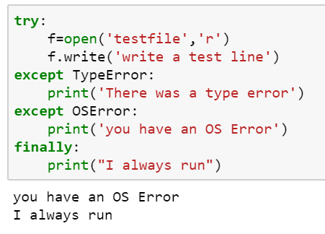
Example 01 - result

Slide 6
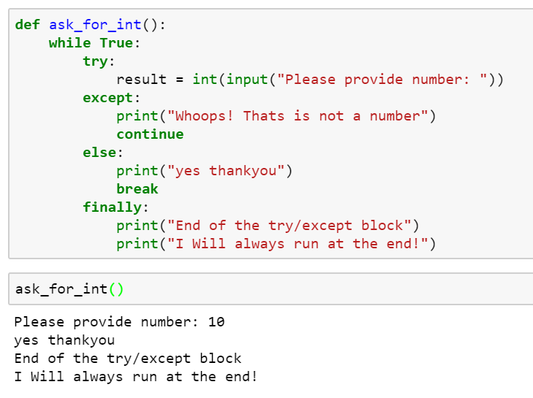

Example 02
What will happen if we enter a string here?
Notes:
def ask_for_int():
while True:
try:
result = int(input("Please provide number: "))
except:
print("Whoops! Thats is not a number")
continue
else:
print("yes thankyou")
break
finally:
print("End of the try/except block")
print("I Will always run at the end!")
ask_for_int()

Slide 7
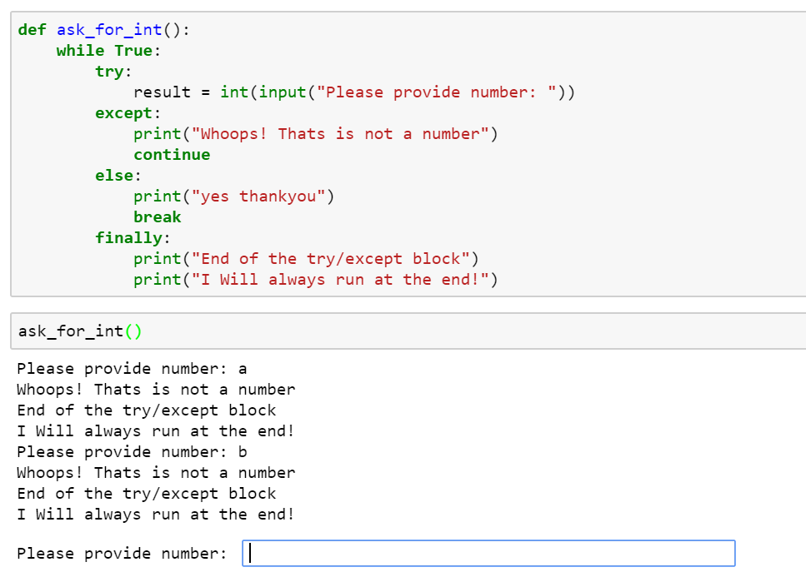

Example 02 - result
Notes:
def ask_for_int():
while True:
try:
result = int(input("Please provide number: "))
except:
print("Whoops! Thats is not a number")
continue
else:
print("yes thankyou")
break
finally:
print("End of the try/except block")
print("I Will always run at the end!")
ask_for_int()

Slide 8
Thank you
The Capacity to learn is a gift;
The ability to learn is a skill;
The willingness to learn is a choice.
-Brian Herbert

